Slide 1
Live application monitoring with Pinba*
*Php Is Not a Bottleneck Anymore

Slide 2
About myself
Ilia Kondrashov http://ikondrashov.com caseycs@gmail.com
I’m doing web development since ~2003 Development / Infrastructure / Product

Slide 3
Feel free to interrupt
We all are here for learning and fun, so let’s try to fill the blanks ✋

Slide 4
We all like to know what’s going on
Business
I’m sure you all know the most popular one!
N2 - we all hate doing this (most frequently used tool by every product owner)
Fire, store and process events (saas/in-house)
Code
Particular pieces of code - measure usage, frequency and outcome option
While developers often hate cronjobs
Performance
Http server logs
NewRelic, AppDynamics, BlackFire etc
Statsd/Pinba
Notes:
What products guys know the most
Easiest way to get honest performance insights - add time to nginx/apache log format

Slide 5
Performance
Maybe slightly touch code metrics
Notes:
In the end we might touch application metrics a bit
There was a great presentation about statsd already here few months ago, so who knows what statsd is and how to use it?

Slide 6
Web application request
From the bottom level
Daemons - DB, cache, events
3rt party API calls
From the infrastructure level
App server
Requested server
From the developer perspective
Groupable details: for example mysql command (select/update), tables
Raw queries, unique details

Slide 7
NewRelic and competitors - our side
Agent is running on every application server
Output batch
Request
PHP
Output batch
Extension
Aggregation
Snapshots
Cloud

Slide 8
NewRelic and competitors - their application
Time-series storage
Post-processing
Samples storage
UI/API

Slide 9
NewRelic and competitors - summary
Extension to instrument PHP stdlib, most popular extensions (curl, pdo), even recognises popular frameworks. Token propagation to external requests. Produces data stream to the local agent.
Local agent for grouping, aggregation, and detailed request snapshots extraction.
Post-processing + storage
Web UI + API

Slide 10
You do not need to build your own performance monitoring tool
Most of the time

Slide 11
What about NewRelic/BlackFire/AppDynamics/etc?
Fancy
Addictive
Expensive
Privacy concerns
Lack of flexibility
Mainstream

Slide 12
Reinventing the wheel
Too small company
Too big company
Concern from business/company to avoid NewRelic (expenses, privacy)
No limitations, real-time, on almost every application, etc, etc
Relevant to anyone here?
Notes:
At least we will get some insights how does it work

Slide 13
Requirements
Amount of data
One user action (for example making a purchase) might mean 100+ memcache/db/api calls
Precision
5% random request without performance stats is usually not a problem
Retention
Performance matters for releases during last 1-2 months, older historical data can be aggregated by 24 hours without major value loss

Slide 14
Request
Context
Application (microservice)
Entry point (controller/action)
Executing server (www*.company.lan)
ID for cross-app linking
Per timer
Tags (rarely unique - daemon name, daemon host, operation)
Time (ms)
Comment (unique)

Slide 15
We defined what to send, what about recipient?
Stream event processors Kapacitor, Riemann Very generic solutions for almost everything, most frequently used in the monitoring
Aggregation Statsd Stateless proxy, flushes every N seconds Pinba Short-time storage (limited by ram) and reports
Notes:
Stream - out of scope
Statsd - maybe we will mention later

Slide 16


PINBA*
*Php Is Not a Bottleneck Anymore
by Antony Dovgal On production since 2006 Open-source since 2009
https://pinba.org
Notes:
Huge monolytic application Let’s for a while forget about our amazing refactoring roadmap, but even now, almost 10 years ago we still have most of the time these huge repositories, right? Who have it?

Slide 17
Pinba engine
In-memory MySQL engine
https://github.com/tony2001/pinba_engine C, ~400 likes
Raw tables with SQL queries support - requests, tags, timers, etc Custom live reports by scripts, servers, hostnames, tags
Operates live and recent data (last X minutes)
Notes:
Receiver

Slide 18
Pinba PHP extension
pinba.so, C code, Google Protobuf, JudyArray
https://github.com/tony2001/pinba_extension ~60 likes
Data batch is pushed via UDP after response is sent to the user
Notes:
Sender

Slide 19
Pinba on scale
One instance for the whole production, separation based on request attributes (host, server).
Separate instance per application
Notes:
On entry level hardware should be enough for 10k rps+

Slide 20
Enough theory
It’s already slide number around 20
How does it look like code-wise?
Notes:
I like current format
Workshop session We know requirements from the bottom
Let’s define requirements on top to think, what do we need in the middle

Slide 21
Defining a request
pinba_script_name_set(array_rand([
'user::register' => true,
'user::logIn' => true,
'user::logOut' => true,
]));
pinba_hostname_set(array_rand(['app1.com' => true, 'app2.com' => true,'app3.com' => true,]));
pinba_server_name_set(array_rand(['www1' => true, 'www2' => true, 'www3' => true,]));

Slide 22
Defining a timer
$timer = pinba_timer_start(['group' => 'memcache', 'op' => 'get', ‘server’ => ‘cache1’]);
usleep(rand(200, 400));
pinba_timer_stop($timer);

Slide 23
Demo infrastructure
let’s say we are making white-labeled platform: app[1,2,3].com
We have memcache/mysql application with nginx www[1,2,3], mysql db[1,2,3] and memcache cache[1,2,3]
And we are measuring user login registration, login and logout

Slide 24
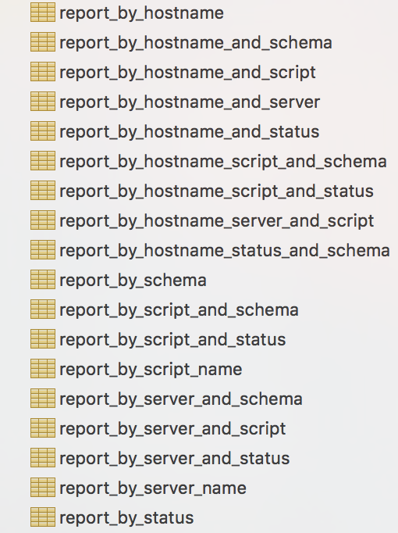
Reports - How does it work
DB tables
Notes:
Predefined reports: script name, server name, hostname and combinations

Slide 25
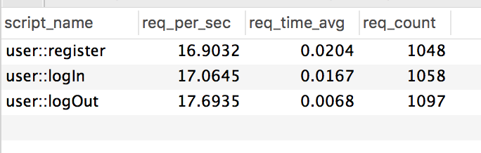
Reports - Application overall
SELECT script_name, req_per_sec, round(req_time_total / req_count,4) AS req_time_avg, req_count FROM report_by_script_and_status ORDER BY req_time_median DESC

Slide 26
Reports - Per cluster - Cache VS DB 1/2
CREATE TABLE `tag_info_group` (
`tag_value` varchar(64) DEFAULT NULL,
`req_count` int(11) DEFAULT NULL,
`req_per_sec` float DEFAULT NULL,
`hit_count` int(11) DEFAULT NULL,
`hit_per_sec` float DEFAULT NULL,
`timer_value` float DEFAULT NULL,
`timer_median` float DEFAULT NULL,
`ru_utime_value` float DEFAULT NULL,
`ru_stime_value` float DEFAULT NULL,
`index_value` VARCHAR(256) DEFAULT NULL
) ENGINE=PINBA DEFAULT CHARSET=latin1 COMMENT='tag_info:group'
Notes:
New reports - new table
Report by 1 tag

Slide 27
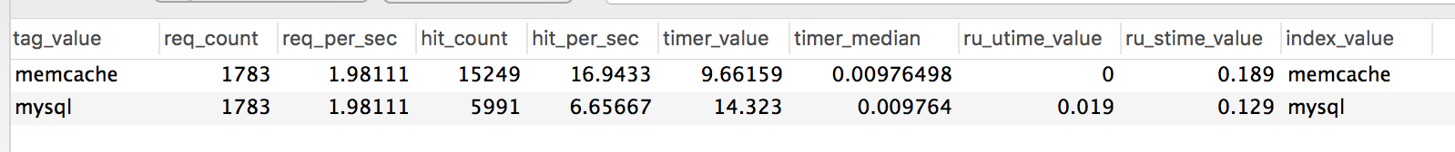
Reports - Per cluster - Cache VS DB 2/2
Notes:
Report by 1 tag - raw data

Slide 28
Reports - Per DB/cache server 1/2
CREATE TABLE `tag_info_server` (
`tag_value` varchar(64) DEFAULT NULL,
`req_count` int(11) DEFAULT NULL,
`req_per_sec` float DEFAULT NULL,
`hit_count` int(11) DEFAULT NULL,
`hit_per_sec` float DEFAULT NULL,
`timer_value` float DEFAULT NULL,
`timer_median` float DEFAULT NULL,
`ru_utime_value` float DEFAULT NULL,
`ru_stime_value` float DEFAULT NULL,
`index_value` VARCHAR(256) DEFAULT NULL
) ENGINE=PINBA DEFAULT CHARSET=latin1 COMMENT='tag_info:server';
Notes:
Totally the same

Slide 29
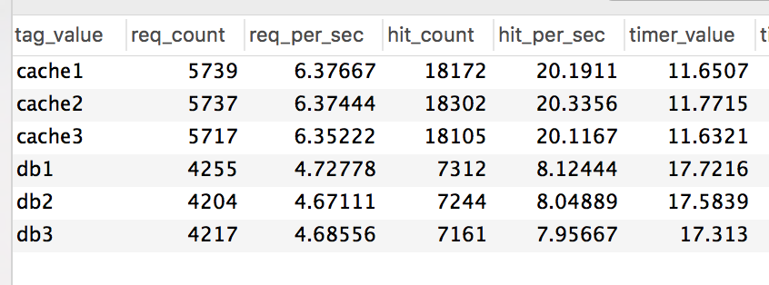
Reports - Per DB/cache server 2/2

Slide 30
Reports - Details for particular request 1/3
CREATE TABLE `tag_report_group_op` (
`script_name` varchar(128) DEFAULT NULL,
`tag1_value` varchar(64) DEFAULT NULL,
`tag2_value` varchar(64) DEFAULT NULL,
`rq_count` int(11) DEFAULT NULL,
`req_per_sec` float DEFAULT NULL,
`ht_count` int(11) DEFAULT NULL,
`hit_per_sec` float DEFAULT NULL,
`timer_value` float DEFAULT NULL,
`timer_median` float DEFAULT NULL,
`index_value` VARCHAR(256) DEFAULT NULL
) ENGINE=PINBA DEFAULT CHARSET=latin1 COMMENT='tag2_report:group,op';
Notes:
Way of making reports for two tags

Slide 31
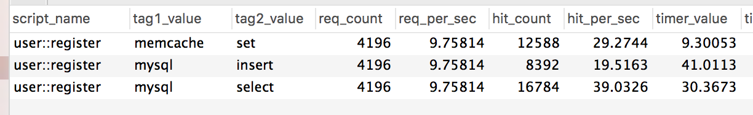
Reports - Details for particular request 2/3
SELECT * FROM tag_report_group_op WHERE script_name="user::register";
Notes:
Raw data

Slide 32
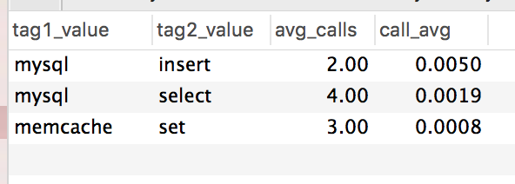
Reports - Details for particular request 3/3
SELECT tag1_value, tag2_value, ROUND(hit_count/req_count,2) AS avg_calls, ROUND(timer_value/hit_count,4) AS call_avg FROM tag_report_group_op WHERE script_name="user::register" ORDER BY timer_value DESC
Notes:
Human-readable way

Slide 33
Reports - Per whitelabel
Notes:
Human-readable way

Slide 34
Open-sources goodies
IDE helpers: https://github.com/misterion/pinba-phpdoc Pre-built PDO and Redis class wrappers
https://github.com/caseycs/redis_pinba https://github.com/caseycs/pdo_pinba
Great pre-build dashboard https://github.com/intaro/pinboard

Slide 35
Fancy graphs
Here you need
Time-series database for storage
Cronjob to put date there
Notes:
Cronjob to collect the stats and

Slide 36
Long term storage
Time-series database Retention
Graphite Simple retention setup Just keys (but search by mask), no extra tags support InfluxDB Native tags support and search by mask More complex retention setup
Notes:
Just to get some value we need data for last at least 10 minutes
Not a problem for pinba itself at all, works out of the box
We want longer - we need to build something extra
Nowadays with the era of Docker it’s not a problem at all.

Slide 37
UI
Grafana
Almost default solution nowadays
Supports all major time series databases
Even json/ELK/mysql
Notes:
How to show our fancy graphs

Slide 38
Extra selling points
Notes:
Everyone is selling us something is this world
Influxdb was so promising and hip, and then they made cluster solution for enterprice usage only

Slide 39
What’s wrong with Pinba
Open-source, but... C, 3rd party, so limited maintainability, no that big community PHP extension Simple to build from sources There are pre-build packages on dotdeb and for homebrew MySQL engine Relatively hard to build from sources There are pre-build packages on dotdeb, also they are updated not that often High entrance barrier - setup, concept, define major tags for the application
Notes:
Unexpected failured, CFLAGS CXXFLAHS, if you have an inftrastructure team they will be not that happy bu regular complaining “who will maintain this thing”

Slide 40
Nice additions
Native nginx instrumentation module to count for example response codes per host.
BTW if you are interested in this part - you can do almost the same with nginx lua module and Prometheus - starting from few years ago.

Slide 41
How to start with Pinba
How to try:
homebrew for php extension
scorcher/pinba-server Docker image for mysql works only with -e MYSQL_ALLOW_EMPTY_PASSWORD=1
Memory footprint with the default settings is ~1.5Gb, because of that it fails on default docker-machine with 1GB of ram. Other then increasing memory for VM you can adjust engine config (less aggregation time), parameters are passed as env variables.

Slide 42
Pinba best practices
Do not combine overlapping measurements in the same mysql
If you want to measure external calls (database/cache) AND particular internal call (templating, routing, framework etc) - put these values in different storage, otherwise sum(time(timers())) > time(request)
For long-running cli/daemon process flush periodically (like every nth timer/second)

Slide 43
StatsD
Few more slides?
Notes:
There was a nice speach about statsd few months ago, let check who is aware of it?

Slide 44
PHP instrumentation for StatsD
Pure PHP, very simple https://github.com/domnikl/statsd-php ~200 likes https://github.com/thephpleague/statsd ~220 likes
TCP/UDP, send on every event or all in batch but custom-triggered Plain text protocol, binary for statsite

Slide 45
StatsD scale
Statsd Simple and straightforward
Central statsd for application (application)
Daemon per application instance + one more final aggregator

Slide 46
StatsD
Stand-alone daemon https://github.com/etsy/statsd NodeJS, ~12k likes https://github.com/statsite/statsite C, ~1.5k lies Input: key+counter/timer/set Output: raw values, sets, mean/min/max, histograms for timers Key is a string, attributes can be emulated with delimiter: daemon.action Instagram Android app launch at 2012 Hosted solution with tag support - DataDog

Slide 47
Pros&cons
Statsd
More generic tool, that can serve multiple purposes
Requires custom development for every use-case
Pinba
Useful for performance metrics only
Both almost does not affect application performance.
Both can handle 10k+ application requests per second (e.g. 20-30 timer per request) almost out of the box, linux network tuning might be required.
Both have bindings for Go, Nodejs, Python, Ruby. Both will not give you complicated requirements our of the box: like inter-microservice request tracking or request snapshots (call tree with timings)

Slide 48
Why I talked so much about StatsD
Because simple counters are extremely useful, and almost effortless.
abstract class StatsdReportingException
{
public function __construct()
{
statsdWrapper::increment(sprintf('exception.%s.%s.%s', currentController(), currentAction(), get_called_class());
parent::__construct();
}
}
Notes:
Performance does not answer the question is your product working well
Measuring small business actions (usage of that particular good filter for the webshop for example)
Also code metrics helps to get application insights - for example which exception are populated and how much - then we put in on the graph and looks at the difference after major release

Slide 49
One more very generic example
abstract class DiContainerResponseStatsdWrapper
{
private $service;
public function __construct($service)
{
$this->service = $service;
}
public function __call($method, array $args = [])
{
statsdWrapper::increment(sprintf('serviceUsage.%s.%s.%s', currentController(), currentAction(), get_class($this->service), $method);
call_user_func_array([$this->service, $method], $args]);
}
}
Notes:
Or even deeper - how our services are used? Can be possible to do with pinba as well

Slide 50
Thanks for listening!
Questions? Ilia Kondrashov caseycs@gmail.com
Code&slides (will be uploaded this evening) https://github.com/caseycs/amsterdam-php-pinba

